Slide 1
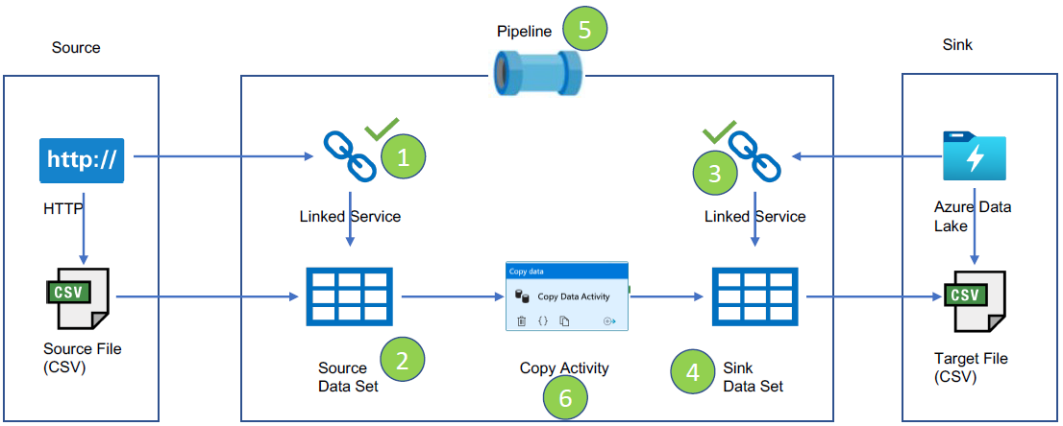

ls_http_auhealthexpnd23_source
ds_auhealthexpnd23_raw_csv_http
ls_adls_auhealthexpnd23dl
ds_auhealthexpnd23_raw_csv_dl
pl_extract_auhealthexpnd_source_data
Copy For Every Record
Parameter file
Storage: Blob storage (auhealthexpnd23sa)
File: JSON (source_file_list.json)
Dataset: ds_auhealthexpnd23_file_list_sa
Linked service: ls_ablob_auhealthexpnd23sa

